Slide 1

SMART TRAFFIC CLEARANCE AND SIGNAL CONTROL SYSTEM USING RSSI AND RFID
Batch Members :
Kamesh Kumar K (190801073)
Karthikeyan H (190801081)
Hariprasad R (190801504)
Guide:
Mr. S. Mohanraj B.Tech., M.E., AP(SS)/ECE

Slide 2
Outline
Motivation
Objectives
Literature Survey
Summary of Literature
Proposed System
Block Diagram
Hardware/Software requirements
Novelty in Proposed System
Results and Discussion
Future work
References

Slide 3
Motivation
“The delay makes the patient's condition worsen, often leading to death”
The primary motivation for this project is likely to improve the efficiency and safety of emergency vehicle traffic at multi-intersection. This could involve reducing delays for emergency vehicles, minimizing the risk of collisions, and improving overall traffic flow at these intersections. Additionally, the project may also aim to optimize the use of resources, such as traffic signal timing, to benefit both emergency vehicles and other road users.
Bengaluru Jun 14, 2022: The death of an elderly man who died while waiting for an ambulance has brought to light the irregularities in the city’s traffic system.

Slide 4
Objectives
To design and develop a smart traffic clearance and signal control system using Radio Frequency Identification (RFID) and Received Signal Strength Indication (RSSI) technologies.
The system aims to improve traffic flow efficiency and reduce congestion at intersections by using RFID tags to identify vehicles lane and RSSI to determine the presence of the Emergency Vehicles.
The system will also dynamically adjust traffic signals based on real-time traffic conditions, providing optimized and safe traffic flow for all road users.
The project will demonstrate the feasibility and effectiveness of using advanced technologies to enhance traffic management and create a safer and more efficient transportation system.

Slide 5
Literature Survey
S.No | Title | Author Name | Year | Technique
1 | A Distributed Emergency Vehicle Transit System Using Artificial Intelligence of Things (DEVeTS-AIoT) | Mahmud, U., Ahmad, B., Roy, N., & Imran, M. A. | 2022 | DEVets-AIoT system collects real-time traffic data through sensors and cameras on emergency vehicles and traffic lights, and processes it using AI to identify the best route for emergency vehicles to reach their destination quickly and safely.
2 | Car e-talk: an IoT-enabled cloud-assisted smart fleet maintenance system | Hussain, S., Javaid, N., Sajjad, M. K., Qureshi | 2022 | Car e-talk utilizes IoT sensors to collect real-time vehicle data and cloud computing to analyze it, using machine learning to predict maintenance issues and scheduling repairs to improve fleet maintenance operations.
3 | Wireless Traffic Control System for Emergency Vehicles Using ZigBee and RSSI | SS. Anusha, R. Mohan | 2021 | The system works by using ZigBee-enabled sensors on emergency vehicles and intersections, measuring the strength of the signal with RSSI to prioritize emergency vehicles' passage through intersections, controlling traffic signals and creating a "green corridor" for them to pass through quickly and safely.

Slide 6
Literature Survey
S.No | Title | Author Name | Year | Technique
4 | Intelligent IoT system for traffic control | A. Guillen-Perez and M.-D. Cano | 2021 | A network of connected sensors and cameras to collect real-time traffic data, which is then processed using AI algorithms to optimize traffic flow and reduce congestion.
5 | IoT based traffic signal management | K. Lalitha and M. Pounambal | 2020 | System works by using sensors and cameras to collect real-time traffic data, which is then processed and analyzed to optimize traffic signal timings and reduce congestion. T
6 | Efficient dynamic traffic control system using wireless sensor networks | Bharadwaj R., Deepak J., Baranitharam M., Vaidehi V.V | 2013 | RFID tags have been used to identify the presence of emergency vehicles and the inductive loop method is used to count vehicles.

Slide 7
Summary of Literature
“Automatic Traffic Monitoring System Using Lane Centre Edges” by Nellore K., Melingi S.B
Drawback - The installation and maintaining a camera-based system may be difficult, making it impractical for widespread use and it may result in inaccurate traffic measurements.
“A GPS based traffic light pre-emption control system for emergency vehicles” by Abubakr S.E, Halla O.A, and Tahani A.A
Drawback - Zigbee has a lower power consumption compared to GPS, which would mean that emergency vehicles would not need to constantly rely on a power source to transmit their location to the traffic lights.

Slide 8
Proposed System
The system utilizes RFID tags on emergency vehicles and RSSI receivers on traffic lights and the other Vehicles. When an emergency vehicle approaches, the RFID tag sends a signal to the RSSI receiver, which triggers a green light for the vehicle. This system helps emergency vehicles navigate through the traffic quickly and efficiently.
However, it does not address the issue of congestion caused by other vehicles on the road. To address this issue, the proposed system also utilizes vehicle-to-vehicle communication. In this system, each vehicle is equipped with a device that communicates with other vehicles on the road.
When an emergency vehicle approaches, it sends a signal to other vehicles, requesting them to move to the side of the road. The system also allows the emergency vehicle to control the speed of other vehicles, ensuring that they do not obstruct the path of the emergency vehicle.

Slide 9
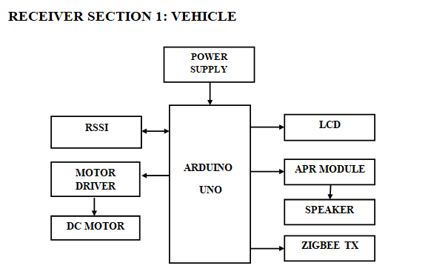
Block Diagram

Slide 10
Block Diagram (Contd..)
Receiver section 2: Traffic signal
POWER SUPPLY
ARDUINO UNO
TRAFFIC SETUP
ZIGBEE RX
RFID READER
RFID TAG

Slide 11
Hardware/Software Requirements
Hardware | Software
ARDUINO UNO | ARDUINO IDE
ESP-8266 | EMBEDDED C LANGUAGE
RSSI (Received Signal Strength Indicator)
ZIGBEE PAIR
DC MOTOR
APR VOICE MODULE
SPEAKER
BUZZER
LCD
POWER SUPPLY

Slide 12
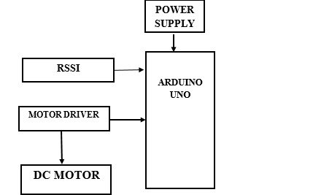
V2V Communication Using RSSI
In this module we interface DC motor and RSSI with arduino UNO controller. Here DC motor act as vehicle. The RSSI(Reveived Signal Strength Indicator) is used to detect the range of ambulance vehicle. RSSI is a measurement of how well your device can hear a signal from an access point or router. It's a value that is useful for determining if you have enough signal to get a good wireless connection.

Slide 13
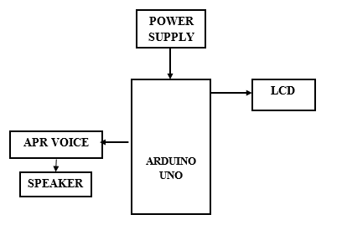
APR Intimation
In this module we interface APR voice module and Liquid crystal display with Arduino uno controller. By interfacing APR voice module to alert the vehicle when the ambulance is near to traffic or far away to the traffic signal. All the information are showed in liquid crystal display.

Slide 14
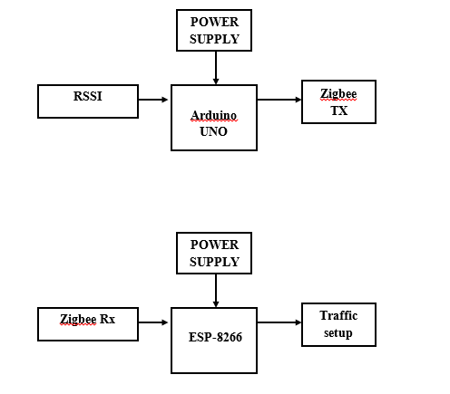
ZIGBEE TRANSMITTING DATA
In this module we interface zigbee and Esp-8266 with arduino uno controller. By interfacing ZigBee technology supports the transfer of data coming from the sensors at a rate of about 250 kbps. The ESP8266 module enables microcontrollers to connect to 2.4 GHz Wi-Fi, using IEEE 802.11 bgn.

Slide 15
Novelty in Proposed System
One new method that could be introduced in traffic control for emergency vehicles is the use of Vehicle-to-Vehicle (V2V) communication technology. This technology would allow emergency vehicles to communicate with other vehicles on the road, alerting them of the emergency vehicle's location and movements and also control their speed using a DC Motor.
This could help to clear a path for the emergency vehicle and allow it to reach its destination more quickly and safely.

Slide 16
Advantages
Our approach would aim to achieve the following goals:
Reduce delays for Emergency vehicles: It reduce the time for the Emergency vehicles to pass through multi-intersection signals, so they can reach their destination faster and provide critical services more efficiently.
Minimize the risk of collisions: It reduce the risk of collisions between emergency vehicles and other road users, to ensure the safety of all parties involved.
Improve overall traffic flow: It optimizes traffic flow to reduce congestion and improve mobility for emergency vehicles and for all road users.
Optimize the use of resources: : Whenever the ambulance approaches the vehicles in road at a certain range it alerts them, and speed of the vehicle is controlled.

Slide 17
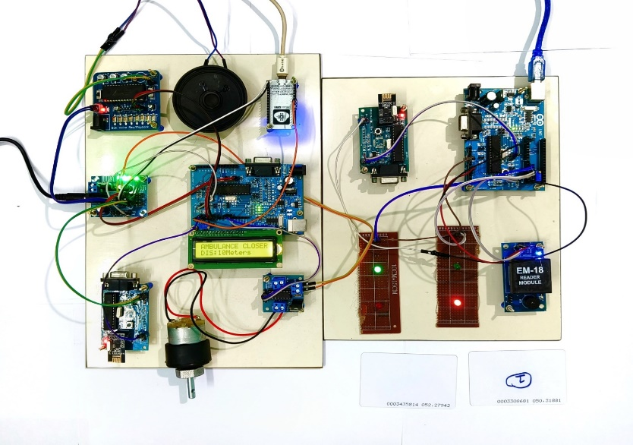
Results and Discussion
Fig.1: Traffic control system for
emergency vehicle

Slide 18
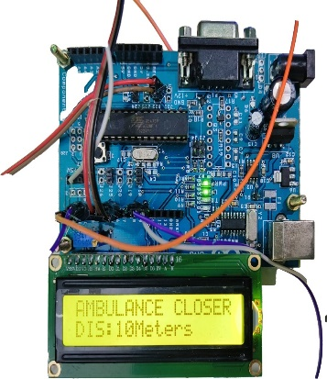
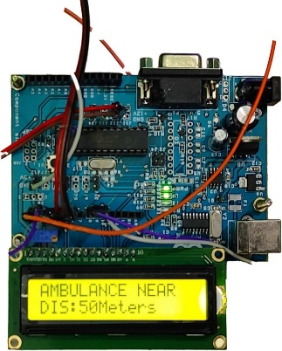
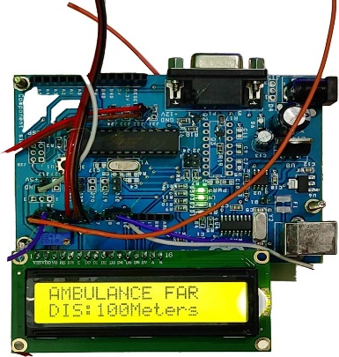
Results and Discussion (Contd..)
When an Ambulance is Closer (10 Meters)
When an Ambulance is Near (50 Meters)
When an Ambulance is Far (100 Meters)
Fig.2: Alert message to apprise people in the vicinity of an Ambulance

Slide 19
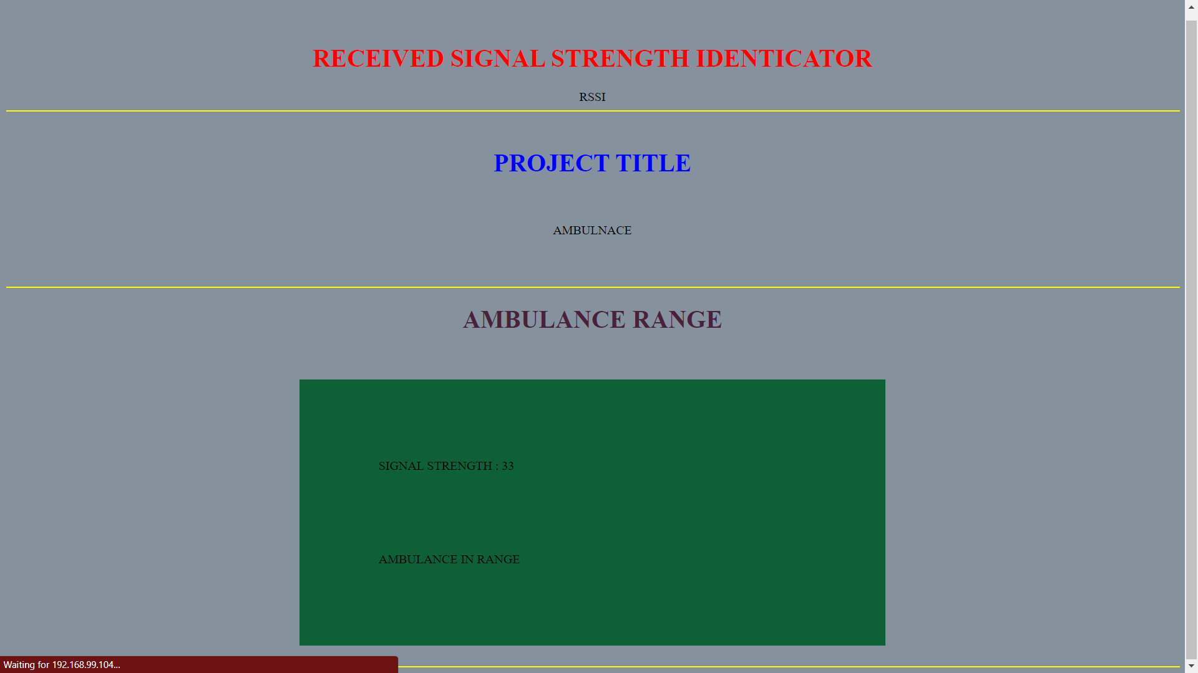
Results and Discussion (Contd..)
Fig. 3: RSSI Result

Slide 20
Future work
Traffic control for emergency vehicles using Zigbee and RSSI could involve the use of cameras by capturing image and enhanced video processing techniques to detect and track emergency vehicles in real-time.
This could involve the use of deep learning algorithms and machine learning techniques to analyse video data and identify emergency vehicles, even in crowded or complex traffic scenes
Another potential application could be the use of cameras to monitor traffic flow and detect congestion, allowing traffic lights to be adjusted in real-time to reduce delays for emergency vehicles. Another innovative way, using cameras with specialized software that can detect emergency vehicles even in low visibility conditions such as fog or heavy rain.
Another possible development could be the integration of cameras with GPS, to provide real-time location information for emergency vehicles, allowing for more efficient and effective traffic control.

Slide 21
References
Umar Mahmud, Shariq Hussain, Amber Sarwar, and Ibrahima Kalil Toure in the paper titled "A Distributed Emergency Vehicle Transit System Utilizing Artificial Intelligence of Things (DEVeTS-AIoT)". Published on August 30, 2022, in Hindwai.
S.S. Anusha et al. in their 2022 International Journal of Advanced Science and Technology (IJAST) article titled "Wireless Traffic Control System for Emergency Vehicles Utilizing ZigBee and RSSI."
"Car e-talk: an IoT-enabled cloud-assisted smart fleet maintenance system" published in IEEE Internet of Things Journal, vol. 1-1 on 2021 by S. Hussain, U. Mahmud, and S. Yang.
An IoT-based congestion control framework for intelligent traffic management system, Advances in Artificial Intelligence and Data Engineering, by M. A. Mondal and Z. Rehena, published in Singapore by Springer in 2021.
A. Guillen-Perez and M.-D. Cano in the paper titled "Intelligent IoT system for traffic control" published on IET Intelligent Transport Systems, vol. 15, no. 2, 2021.
P. Sankar and G. Voorandoori in the paper titled "Intelligent transportation systems in diverse traffic conditions" published in Internet of Vehicles and Its Applications in Autonomous Driving, 2021.

